Slide 1
Universidade de Lisboa – Instituto Superior de Economia e Gestão
Programa de Doutoramento em Gestão
Metodologias de Investigação (2023/2024)
Prof. Dr. Curado
04 October 2023
Article Review:
Vermeulen, F. 2005. On rigor and relevance: Fostering dialectic progress in management research.
Academy of Management Journal, 48(6), 978–982
Key Premise
Management research does not sufficiently influence management practice
Presenters
Carlos Rutigliani Vasconcellos | <crvasconcellos@phd.iseg.ulisboa.pt>
Jamie Pierre Bridel | <jamie.bridel@phd.iseg.ulisboa.pt>
Notes:
Intro to Frank Vermuelen and LBS thinking.

Slide 2
Management Research – Rigour and Relevance
Declaration of Integrity
Declaro que conduzi este trabalho com integridade. Confirmo que não utilizei plágio ou qualquer forma de falsificação de resultados no processo de elaboração deste trabalho. Confirmo também que não foram usadas ferramentas de inteligência artificial que utilizam tecnologia de transformação e/ou geração digital e modelos de aprendizagem virtual durante a elaboração deste trabalho. Declaro ainda que tomei pleno conhecimento, respeitei e segui o Código de Conduta Ética da Universidade de Lisboa.
Notes:
Relevance must be established in the question, and rigor in the method applied to provide the answer.
That is, all research questions must be relevant; the research design and execution (as far as we can tell from the available sources) must be academic and rigorous.

Slide 3
Management Research – Rigour and Relevance
Introduction
1 | There is an enduring gulf between academic research and management practice.
2 | Academic answers often lack practical meaning because the questions that were asked to start with lacked relevance.
3 | "Relevance must be established in the question, and rigor in the method applied to provide the answer: the research questions must be relevant, the research design and execution must be academic and rigorous” (Vermeulen, 2005).
4 | Evolve the Academic ecosystem with closer engagement with business management.
Conclusion | Scepticism | Without changes to our academic system, it is impossible to generate research that impacts management professionals.
 | Optimism | Systemic change will happen by bringing Academic publishing closer to practitioner journals and executive education (a better ecosystem). Research in Management and Organisations is a long-term contributor to society (through better-performing businesses).
Notes:
Relevance must be established in the question, and rigor in the method applied to provide the answer.
That is, all research questions must be relevant; the research design and execution (as far as we can tell from the available sources) must be academic and rigorous.

Slide 4
Management Research – Rigour and Relevance
Background
A Nagging Concern
For over 100 years academics have debated whether (and how) Management Research can better combine relevance with rigorous, replicable methods.
That debate stemmed from the awareness that business attributed little value to research, with 4 core topics:
That research methods are rigorous, verifiable, repeatable.
That hypothesis and outcomes are relevant, measured by impact on individuals and organisations.
Challenges in systematically gathering & organising data (Gambardella, 2012).
Closure of the science (to avoid influences) while assuring effective communication to practitioners (Vicari, 2013).
Some believe that Academia exerts a low influence on management practice. Most debate now changing the system (Rajagopalan, 2020) with close, constant engagement between academia and business
Timeline
Early 1900’s
- Trade Schools & War Stories
Less Systematic Research
Focus on Rigour
1950’s
- Graduate School of Industrial Administration
- Inaugural issue of Administrative Science Quarterly
- Expansion of “practitioner journals”
Systemic Research losing sight of Relevance
- Organizational Research Methods launched
2000’s
Moving towards real problems with Rigour!
More corporate externships please!
Today
Figure 1: created by the presenters
Notes:
practitioners (e.g. in Academic Journals vs. Practitioner Journals vs. Exec Education).
The World Outside the Article
What do other papers/article posit?
Is there an article presenting a conflicting viewpoint?
What is the consensus?
Dialectic – who has (or had) opposing views?
More qualitative?
More quantitative?
qualitative-quantitative and micro-macro dimensions

Slide 5
Management Research – Rigour and Relevance
Relevance
Making a Difference
Perception of limited societal contribution: "how our research ... improve business, in comparison, was devoid of such meaning, and how great it must be to be able to make a real, direct contribution to society; all we did, at best, was help businesses make more money" (Vermeulen, 2005).
Identify research purpose, context, and impact: "it is up to individual researchers to figure out what they want to examine and advancing “profitability” is one worthy cause. Moreover, ... is not the area it addresses..., but how it addresses" (Vermeulen, 2005).
Regardless, rigor always: "Relevance is then found in the question, rigor in the method applied to provide the answer." (Vermeulen, 2005).
Observations
The controverse between relevance and utility.
Management research can be placed on a continuum between basic and applied research (Saunders, Lewis, Thornhill, 2016).
Enablers of relevance in management research (Vermeulen, 2005)
theoretical constructs translation
trade-offs contextualization
variables under managers' control
mix of different research methods
Notes:
How original is the topic?
What does it add to the subject area compared with other published material?

Slide 6
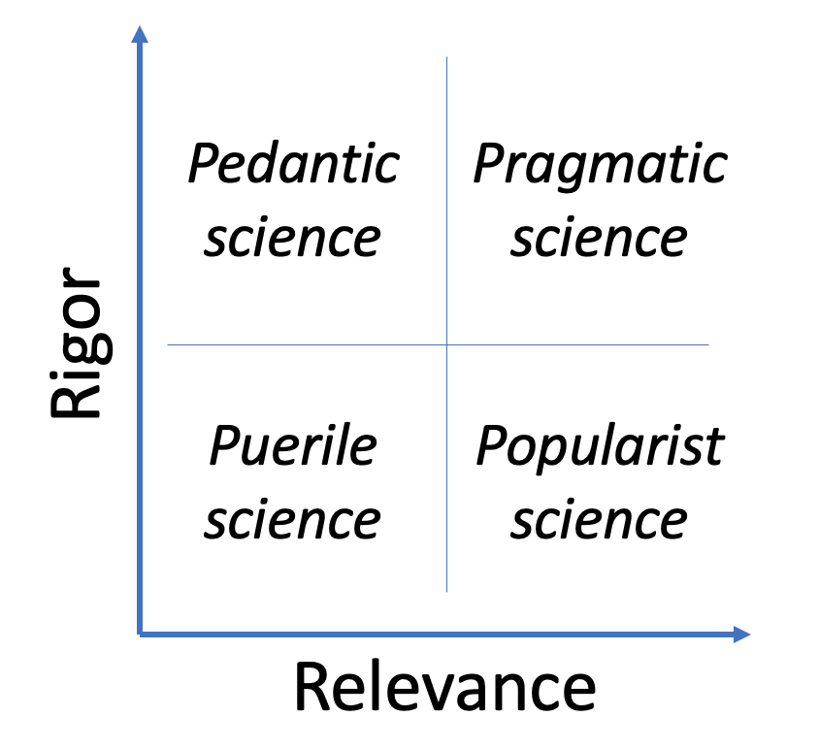
Management Research – Rigour and Relevance
Challenges
The Research-Practice Gap
The closed nature of academic publishing: "We read each others’ papers in our journals and write our own papers so that we may, in turn, have an audience . . . : an incestuous, closed loop” (Vermeulen, 2005).
Poor collaboration and inspiration from practitioners: "By cutting practitioners as an audience out of the loop, we cut out reality from the academic cycle"(Vermeulen, 2005).
Lack of synthesis: "Academic journals may be guilty of publishing dull and irrelevant findings. Practitioner journals are often guilty of publishing provocative and counterintuitive claims that sell well but that imply unsupported prescriptions"(Vermeulen, 2005).
Observations
Academic literature and journals are not popular among practitioners due to their immediatism pursuit (Vicari, 2013).
Distinct points of view of knowledge: researcher's "why" vs. practitioner's "how-to” (Saunders et al., 2016).
Reconcile and synthesize at the research question, not balance rigor and relevance (Vermeulen, 2005; Saunders et al., 2016; Vicari, 2013).
+
-
-
+
Figure 2: adapted from Saunders et al., 2016
Notes:
How original is the topic?
What does it add to the subject area compared with other published material?

Slide 7
Management Research – Rigour and Relevance
Opportunities
Recommendations for Rigor and Relevance
Corporate externships and research sabbaticals move academics closer to the daily business and organizational initiatives (Rajagopalan, 2020).
Incentives such as “[…] encourage and reward interdisciplinary work that takes place at the intersection of multiple fields” (Rajagopalan, 2020).
Knowledge Brokers “[…] whose task would be to give life to a research result transfer market, similarly to what has been identified for research in the technology field” (Vicari, 2013).
Qualitative and action research, with different research designs (such as engaging practitioners) and continuous knowledge-sharing (Vicari, 2013).
Observations
If researchers want their research to be used, they should disseminate their research findings in magazines read by users as well as in professional journals (Beyer, 1982)
Management journals (HBR, MIT Sloan Review, Wharton Review, etc.) publish more ‘applicable’ research, targeted at management professionals which generate interest and traction.
Notes:
How original is the topic? What does it add to the subject area compared with other published material?
Adopt management ’Best Practices’ which typically follow deductive methods that evidence-based management (EBM) supports
Systemic change will take a long time and requires a major change to research incentives!

Slide 8
Management Research – Rigour and Relevance
References
Beyer, J. and Trice, H, (1982). The Utilization Process: A Conceptual Framework and Synthesis of Empirical Findings. Administrative Science Quarterly , 27(4), 591-622
Gambardella, A., (2012). Three pitches for three papers that EMR would like to publish. European Management Review, 9(3), 117–119.
Rajagopalan, N., (2020). Rigor, Relevance, and Resilience in Management Research. Journal of Management Inquiry, 29(2), 150–153
Saunders, M., Lewis, P. and Thornhill, A. (2016). Research methods for business students (7th Ed.). Harlow: Pearson Education Limited.
Vermeulen, F. (2005). On Rigor and Relevance: Fostering Dialectic Progress in Management Research. The Academy of Management Journal, 48(6), 978–982
Vermeulen, F. (2007). “I shall not remain insignificant”: Adding a second loop to matter more. Academy of Management Journal, 50(4), 754-761
Vicari, S. (2013). Is the Problem Only Ours?. European Management Review, 10(4), 173–181
Notes:
How original is the topic? What does it add to the subject area compared with other published material?
Adopt management ’Best Practices’ which typically follow deductive methods that evidence-based management (EBM) supports
Systemic change will take a long time and requires a major change to research incentives!

Slide 9
Thank You | Obrigado pela sua atenção
Carlos Rutigliani Vasconcellos | <crvasconcellos@phd.iseg.ulisboa.pt>
Jamie Pierre Bridel | <jamie.bridel@phd.iseg.ulisboa.pt>

